Slide 1
Securing the IoT end to end
Notes:
Information in this document, including URL and other Internet Web site references, is subject to change without notice. Unless otherwise noted, the example companies, organizations, products, domain names, e-mail addresses, logos, people, places, and events depicted herein are fictitious, and no association with any real company, organization, product, domain name, e-mail address, logo, person, place or event is intended or should be inferred. Complying with all applicable copyright laws is the responsibility of the user. Without limiting the rights under copyright, no part of this document may be reproduced, stored in or introduced into a retrieval system, or transmitted in any form or by any means (electronic, mechanical, photocopying, recording, or otherwise), or for any purpose, without the express written permission of Microsoft Corporation.
Microsoft may have patents, patent applications, trademarks, copyrights, or other intellectual property rights covering subject matter in this document. Except as expressly provided in any written license agreement from Microsoft, the furnishing of this document does not give you any license to these patents, trademarks, copyrights, or other intellectual property.
The names of manufacturers, products, or URLs are provided for informational purposes only and Microsoft makes no representations and warranties, either expressed, implied, or statutory, regarding these manufacturers or the use of the products with any Microsoft technologies. The inclusion of a manufacturer or product does not imply endorsement of Microsoft of the manufacturer or product. Links may be provided to third party sites. Such sites are not under the control of Microsoft and Microsoft is not responsible for the contents of any linked site or any link contained in a linked site, or any changes or updates to such sites. Microsoft is not responsible for webcasting or any other form of transmission received from any linked site. Microsoft is providing these links to you only as a convenience, and the inclusion of any link does not imply endorsement of Microsoft of the site or the products contained therein.
© 2019 Microsoft Corporation. All rights reserved. Microsoft and the trademarks listed at https://www.microsoft.com/en-us/legal/intellectualproperty/Trademarks/Usage/General.aspx are trademarks of the Microsoft group of companies. All other trademarks are property of their respective owners.

Slide 2
Abstract and learning objectives
In this whiteboard design session, you will work with a group to design an end-to-end solution that leverages Microsoft Azure's IoT features, tools and resources to secure and monitor a set of IoT devices.
At the end of this session, you will be better able to design and recommend solutions that help organizations properly secure and monitor their IoT-based infrastructure.

Slide 3
Step 1: Review the customer case study
Outcome
Analyze your customer needs
Timeframe
15 minutes

Slide 4
Customer situation
Contoso, Ltd. has major holdings in one of the world’s most important oil-producing regions.
Their environments are very tough environments in which to work. The climate is hot, harsh, and unforgiving, and oil wells are often spaced many miles apart
They want to deploy IoT technologies to electronically collect data and use cloud based solutions to store and analyze it in order to gain new insights into well operations and future drilling possibilities.

Slide 5
Customer needs
Ensure that all IoT devices are properly registered and assigned a secure tamperproof identity.
Ensure devices are operating within assigned policy standards and are not tampered with.
Enable an alerting solution with little to no effort configuration that will notify and allow for remediation in the case of fault or malicious activity.
Ensure all events are surfaced in one place for simplicity.

Slide 6
Customer needs
Address the need to have auditing and monitoring across a wide range of device operating systems and processor architectures (Linux, x86, x64, etc).
Automate the security agent provisioning rather than having to physically or remotely "touch" all the devices.
Ensure only the most secure protocols are implemented and used during any transmissions
Ensure that in the future it will be possible to have an enterprise-wide look at any vulnerabilities or malicious events, not just specifically focused the IoT infrastructure.

Slide 7
Customer objections
Contoso, Ltd staff are worried it may be impossible to manage the many thousands of IoT devices they have deployed around the world with any one product.
Can Azure handle all the different types of operating systems and processor architectures of their devices?
Will they be able to monitor for specific events on some of their proprietary devices?
Can Azure support non-TPM hardware devices?
Will the communications from a device to Azure be secure enough?

Slide 8
Customer objections
Can an Azure logging solution handle the massive amount of events and alerts that will need to be ingested?
Is it possible to assign role-based permissions based on their security objectives and policies to the IoT resources such as the Hub, Edge and individual devices?
Is the solution capable of being flexible in the types of reporting and alerts that can be generated based on custom logging event data?
Will we be able to limit the messages and network traffic to specific network IP addresses/subnets for our devices?

Slide 9
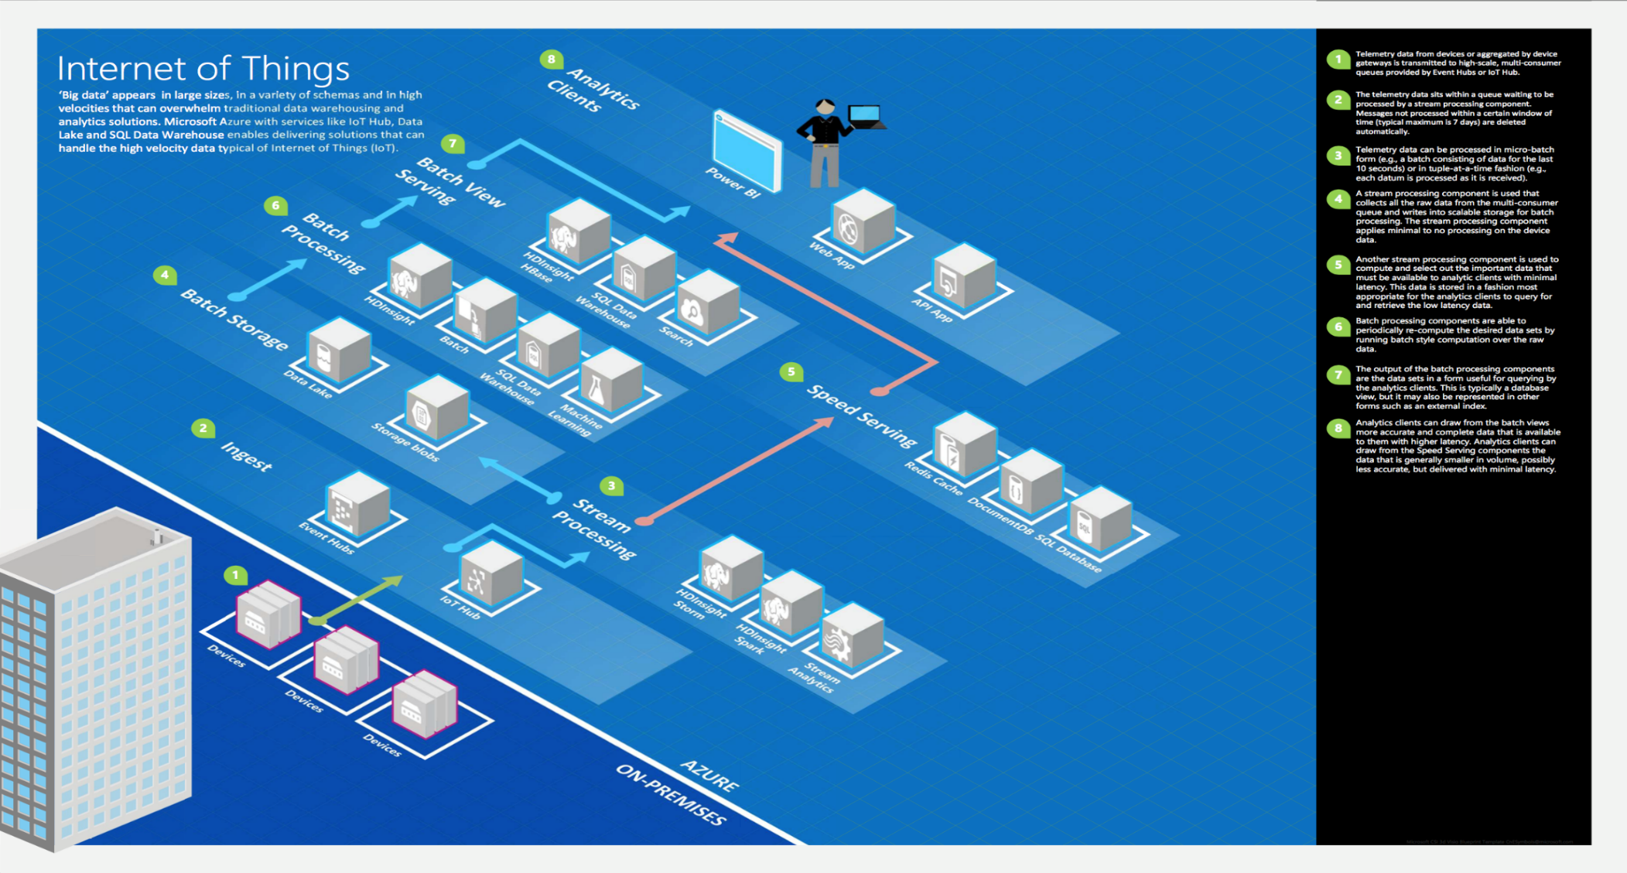
Common scenarios

Slide 10
Step 2: Design the solution
Outcome
Design a solution and prepare to present the solution to the target customer audience in a 15-minute chalk-talk format.
Timeframe
60 minutes
Business needs (10 minutes) | Respond to questions outlined in your guide and list the answers on a flipchart
Design (35 minutes) | Design a solution for as many of the stated requirements as time allows. Show the solution on a flipchart
Prepare (15 minutes) | Identify any customer needs that are not addressed with the proposed solution Identify the benefits of your solution Determine how you will respond to the customer’s objections Prepare for a 15-minute presentation to the customer

Slide 11
Step 3: Present the solution
Outcome
Present a solution to the target customer in a 15-minute chalk-talk format
Timeframe
30 minutes (15 minutes for each team to present and receive feedback)
Directions
Pair with another table
One table is the Microsoft team and the other table is the customer
The Microsoft team presents their proposed solution to the customer
The customer asks one of the objections from the list of objections in the case study
The Microsoft team responds to the objection
The customer team gives feedback to the Microsoft team

Slide 12
Wrap-up
Outcome
Identify the preferred solution for the case study
Identify solutions designed by other teams
Timeframe
15 minutes

Slide 13
Preferred target audience
IoT Developers and Support
Cloud Architects
Infrastructure Managers
Network Engineers

Slide 14
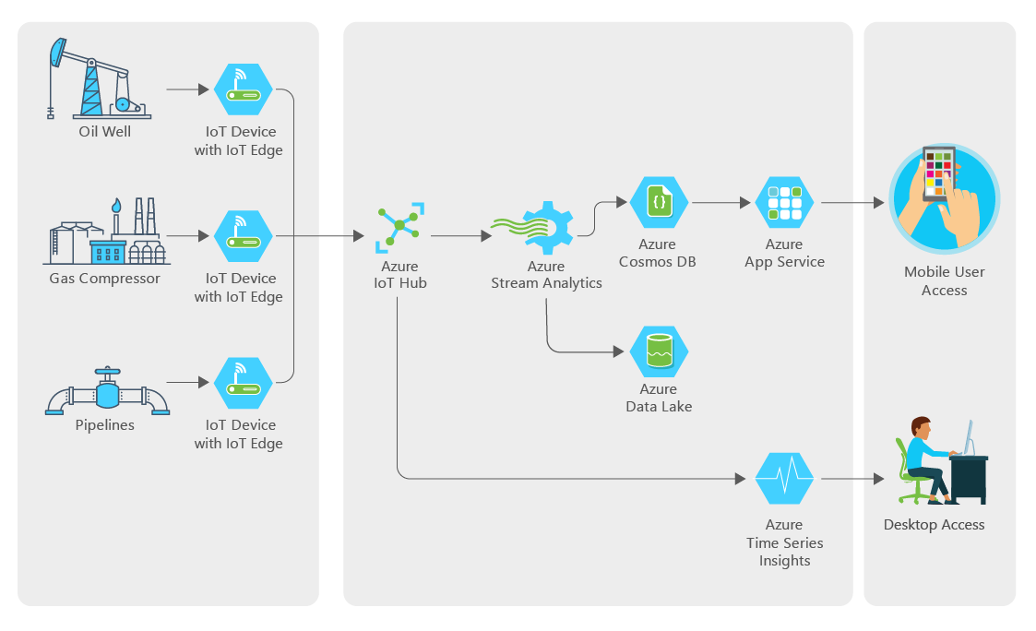
Preferred Solution

Slide 15
Preferred solution
Topology
Azure IoT Hubs will keep track of devices and allow for remote execution of commands, deployments and the receiving and routing of device messages.
Azure IoT Device Provisioning Service will be used to register the oil wells, gas compressors and pipelines devices with the appropriate IoT Hubs.
Azure IoT Edge devices will be used to store information when offline and then forward to the IoT Hub.
Use custom endpoints and routes in IoT Hub to filter and send critical messages to a Service Bus Queue for further processing.

Slide 16



Preferred solution
Device
Use IoT Hub to manage devices, ingest all data, and send control data back to devices as needed.
Process oil well data locally, detect anomalies, store data offline, and send only important data, using Azure IoT Edge devices.
Separately send oil pipeline metrics at regular intervals.

Slide 17
Preferred solution
Security And Logging
Azure Security Center for IoT will be used to provide workload protection through its intelligent threat detection analysis algorithms.
Azure Security Agent will be deployed to all critical devices to feed important security events and data to Azure Security Center for IoT.
Log Analytics will be used to build custom alerts based on device security data ingested from the Azure Security Agents.

Slide 18
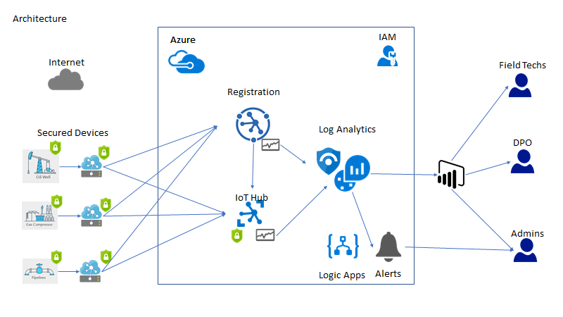
Preferred Solution (Architecture)

Slide 19
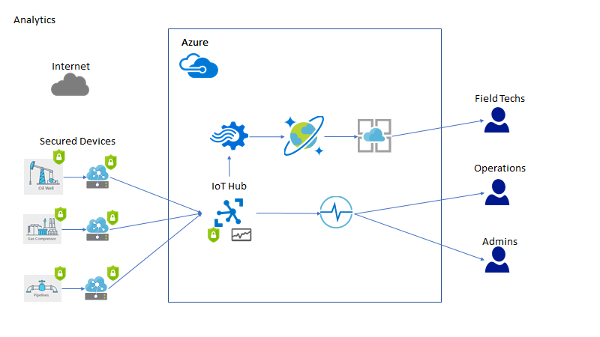
Preferred Solution (Analytics)

Slide 20
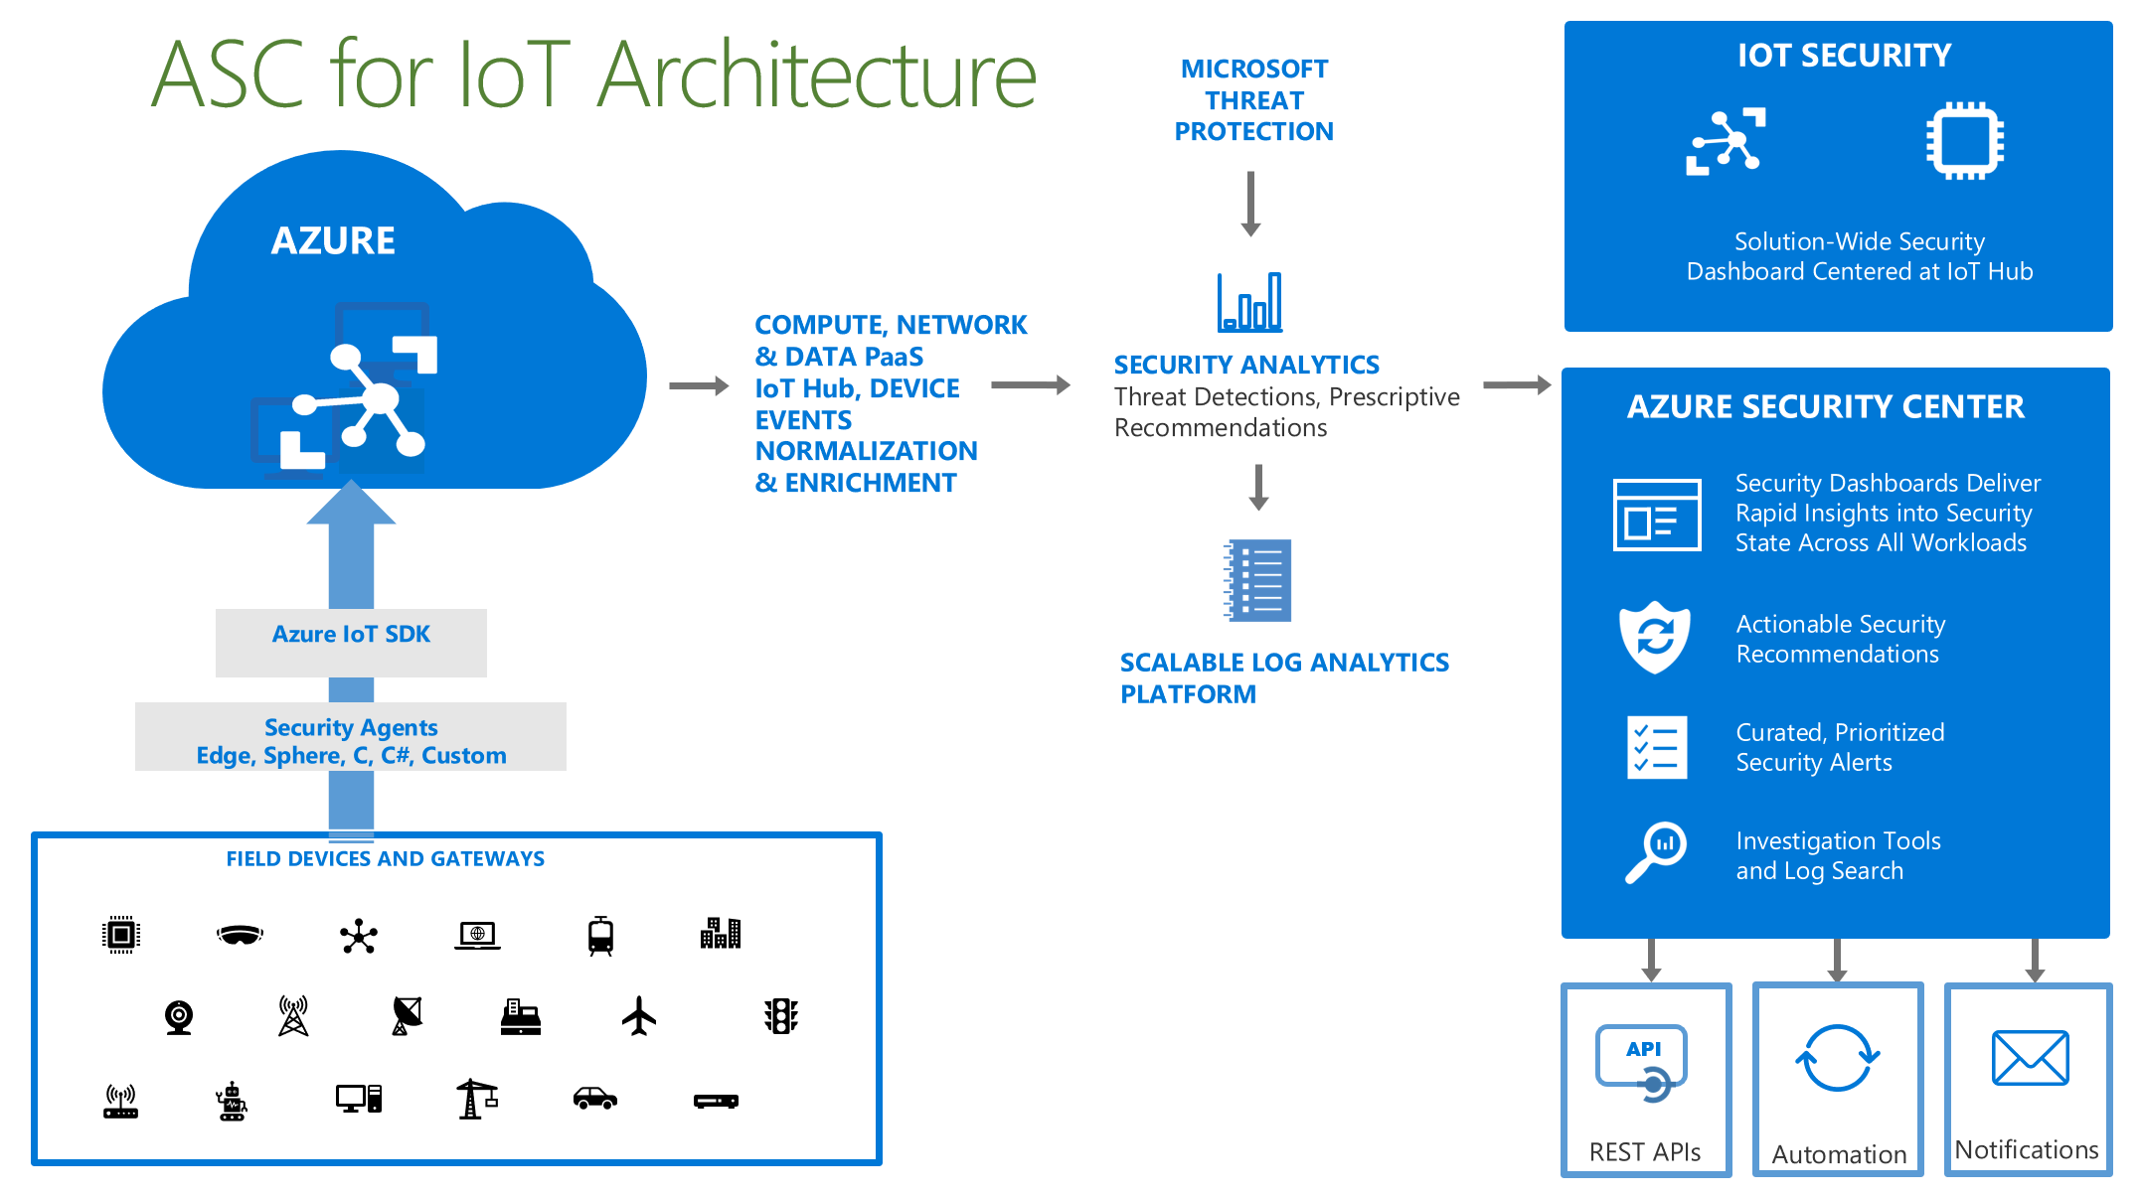
Preferred Solution (Security)

Slide 21


Preferred solution
Reporting and Analytics
Stream Analytics can monitor device data for alert thresholds and separately send all device data to Cosmos DB.
Use Azure Time Series Insights to store, visualize, and query all-time series data from IoT and edge devices.
Overlay device telemetry and other data all in one place, automatically handle schema changes and view raw data.
Use Cosmos DB to store reference data, alert information, device data, and oil well metrics used for detecting anomalies and output efficiency.
Custom web app hosted in Web Apps service, accesses time series data via Time Series Insights Query APIs, connects to Cosmos DB for reference data, and manages IoT devices through IoT Service SDK.

Slide 22
Preferred objections handling
Contoso, Ltd staff are worried it may be impossible to manage the many thousands of IoT devices they have deployed around the world with any one product.
Can Azure handle all the different types of operating systems and processor architectures of their devices?
Will they be able to monitor for specific events on some of their proprietary devices?
Can Azure support non-TPM hardware devices?
Notes:
Contoso, Ltd staff are worried it may be impossible to manage the many thousands of IoT devices they have deployed around the world with any one product.
- Utilizing the Azure IoT Hub Device Provisioning Service, Contoso can enable a zero-touch, just-in-time provisioning to specific IoT hubs without any human intervention. The service scales to many millions of devices in a secure and scalable manner that will meet Contoso's needs.
Can Azure handle all the different types of operating systems and processor architectures of their devices?
- The Azure IoT Agents have been release with ANSI-C standards in mind. The code is freely available on GitHub along with an entire SDK that will enable Contoso to easily re-compile the source for any target device.
Will they be able to monitor for specific events on some of their proprietary devices?
- Yes, they can monitor for custom events on their proprietary devices using the Azure IoT SDK to send message and events to their specific IoT Hub(s).
Can Azure support non-TPM hardware devices?
- Yes, you can recompile the source code to utilize simulated/software TPMs, however this is not a standard or accepted way of doing secure device management in production environments.
5. Will the communications from a device to Azure be secure enough?
- Absoultely, the Azure IoT SDKs come with support for several different protocols including the latest HTTPS and SSL features.
6. Can an Azure logging solution handle the massive amount of events and alerts that will need to be ingested?
- Yes, at the lowest plan level, you can send 500MB of data to a Log Analytics workspace. Standard and Premium plans have no limit on the amount of data uploaded even if it is terabytes per day.
7. Is it possible to assign role-based permissions based on their security objectives and policies to the IoT resources such as the Hub, Edge and individual devices?
- Yes, Azure IoT resources come with a management plane that gives you flexibility to allow various levels of permissions to target specific roles of your IoT Infrastructure.
8. Is the solution capable of being flexible in the types of reporting and alerts that can be generated based on custom logging event data?
- Yes, you can choose to utilize the out of box alert templates, or create your own templates based on common Azure and Operating System events, or even your own custom events.
9. Will we be able to limit the messages and network traffic to specific network IP addresses/subnets for our devices?
- Yes, you can enable IP Filtering in the IoT Hub to ensure that only messages that originate from specific IPs or subnet are allowed to flow through to the IoT Hub(s).

Slide 23
Preferred objections handling
Will the communications from a device to Azure be secure enough?
Can an Azure logging solution handle the massive amount of events and alerts that will need to be ingested?
Is it possible to assign role-based permissions based on their security objectives and policies to the IoT resources such as the Hub, Edge and individual devices?
Is the solution capable of being flexible in the types of reporting and alerts that can be generated based on custom logging event data?
Will we be able to limit the messages and network traffic to specific network IP addresses/subnets for our devices?
Notes:
Will the communications from a device to Azure be secure enough?
- Absoultely, the Azure IoT SDKs come with support for several different protocols including the latest HTTPS and SSL features.
Can an Azure logging solution handle the massive amount of events and alerts that will need to be ingested?
- Yes, at the lowest plan level, you can send 500MB of data to a Log Analytics workspace. Standard and Premium plans have no limit on the amount of data uploaded even if it is terabytes per day.
Is it possible to assign role-based permissions based on their security objectives and policies to the IoT resources such as the Hub, Edge and individual devices?
- Yes, Azure IoT resources come with a management plane that gives you flexibility to allow various levels of permissions to target specific roles of your IoT Infrastructure.
Is the solution capable of being flexible in the types of reporting and alerts that can be generated based on custom logging event data?
- Yes, you can choose to utilize the out of box alert templates, or create your own templates based on common Azure and Operating System events, or even your own custom events.
Will we be able to limit the messages and network traffic to specific network IP addresses/subnets for our devices?
- Yes, you can enable IP Filtering in the IoT Hub to ensure that only messages that originate from specific IPs or subnet are allowed to flow through to the IoT Hub(s).

Slide 24
Customer quote
"Managing our massive worldwide IoT Infrastructure using the latest security features of Azure has given us the confidence to know our devices are running securely and efficiently with the added flexibility to change our direction at any time."
Jack Tradewinds, CIO of Contoso, Ltd.

